Slide 1


WDI - EKC Sustainability Assessment Framework
I. RESEARCH AIMS
Primary Goal: To verify the true shape of the Environmental Kuznets Curve (EKC) by controlling for country-specific biases using robust Panel Fixed Effects (FE) models.
Policy Focus: The study identifies leaders in "Absolute Decoupling" (Green Growth) to provide empirical models for effective sustainability policies.
II. METHODOLOGY AND DATA STRUCTURE
Core Model: We used WDI Panel Data (2000–2020) to regress CO2 on log(GDP) and its square.
Validation: The Hausman Test confirmed the Fixed Effects (FE) model was the statistically consistent and superior estimator for this analysis.
III. FINDINGS AND CONCLUSIONS
EKC Confirmation: FE analysis confirmed the Inverted U-Shape (EKC), but the low explanatory power (R² ≈ 4.4%) shows that mere GDP growth is an insufficient driver.
Key Takeaway: While the EKC exists, CO2 reduction is primarily driven by policy and technological intervention, as proven by Green Growth Candidates like Denmark and Ireland.
IV. DISCUSSION AND SECTORAL RECOMMENDATIONS
Model Implication: Policymakers should not wait for wealth accumulation, but must actively adopt measures like Carbon Pricing to accelerate the decline phase.
Action: Developing nations must utilize Renewables to "leapfrog" the costly climb, while developed nations must invest in Carbon Capture to target net-negative emissions.
Team Leader: Meriç Özcan; Team Members: Ali Kınış and Ahmet Aslan

Slide 2
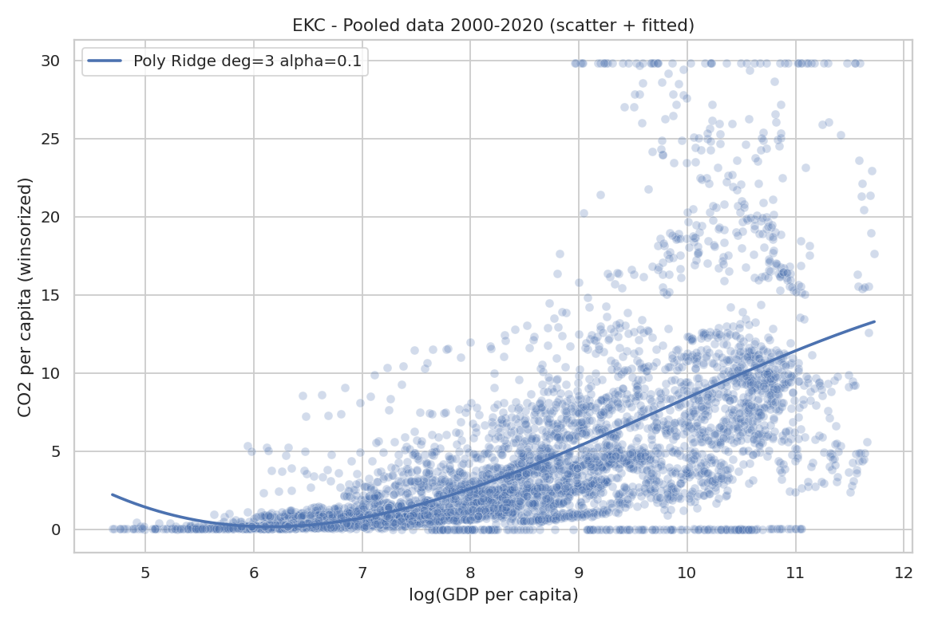
GENEL BAKIŞ

Slide 3
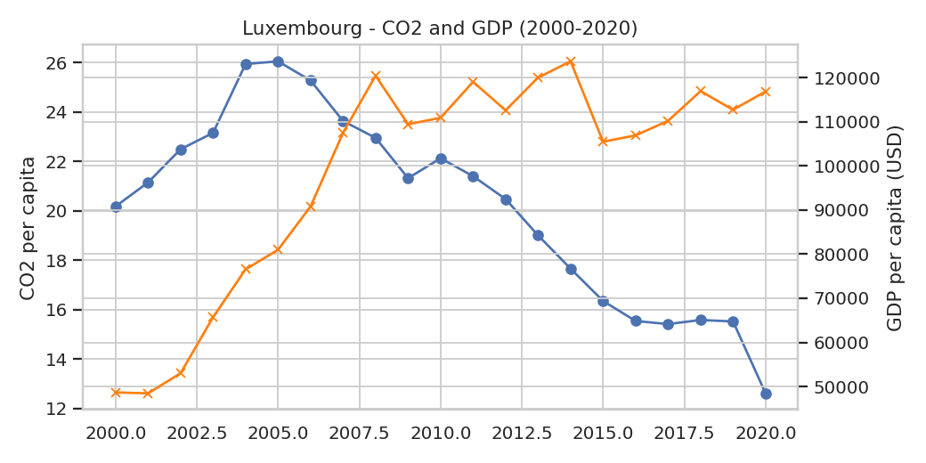
01

Slide 4
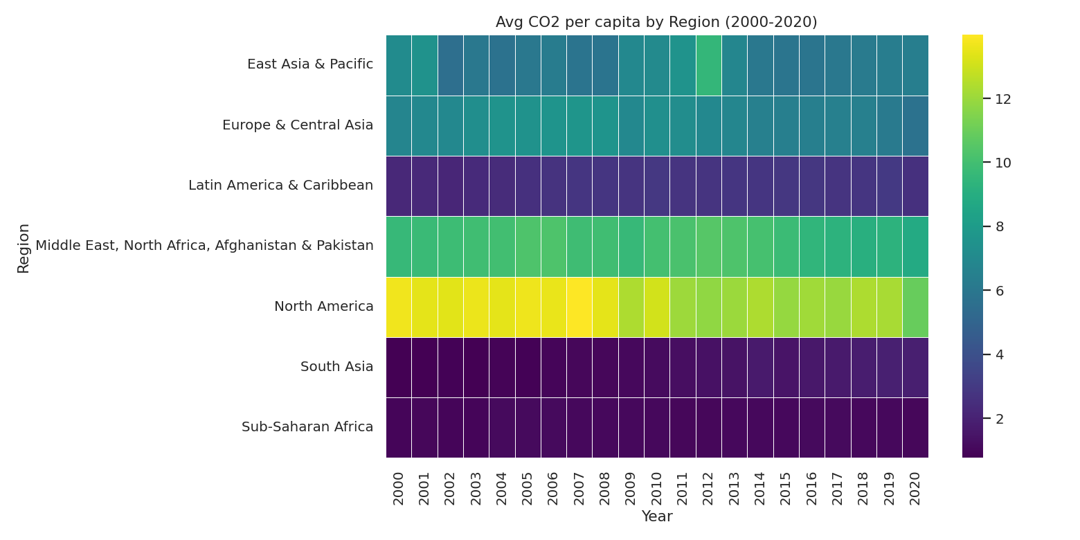
01
04

